Slide 1
Introduction & Passive Components
Intro to DIY Circuit Design
Zhiyang Tsao
Summer 2024

Slide 2

About me
陈 悦开 / Pieski
Electronic Information Engineering,
College of EE, Zhejiang Univ.
Power Electronics
Nothing else, actually
E-mail: tsaozy@zju.edu.cn / tinesharp@outlook.com (after graduation)
Github: https://github.com/Pieski
Wechat: “脑子有坑”in every xlab wechat group

Slide 3

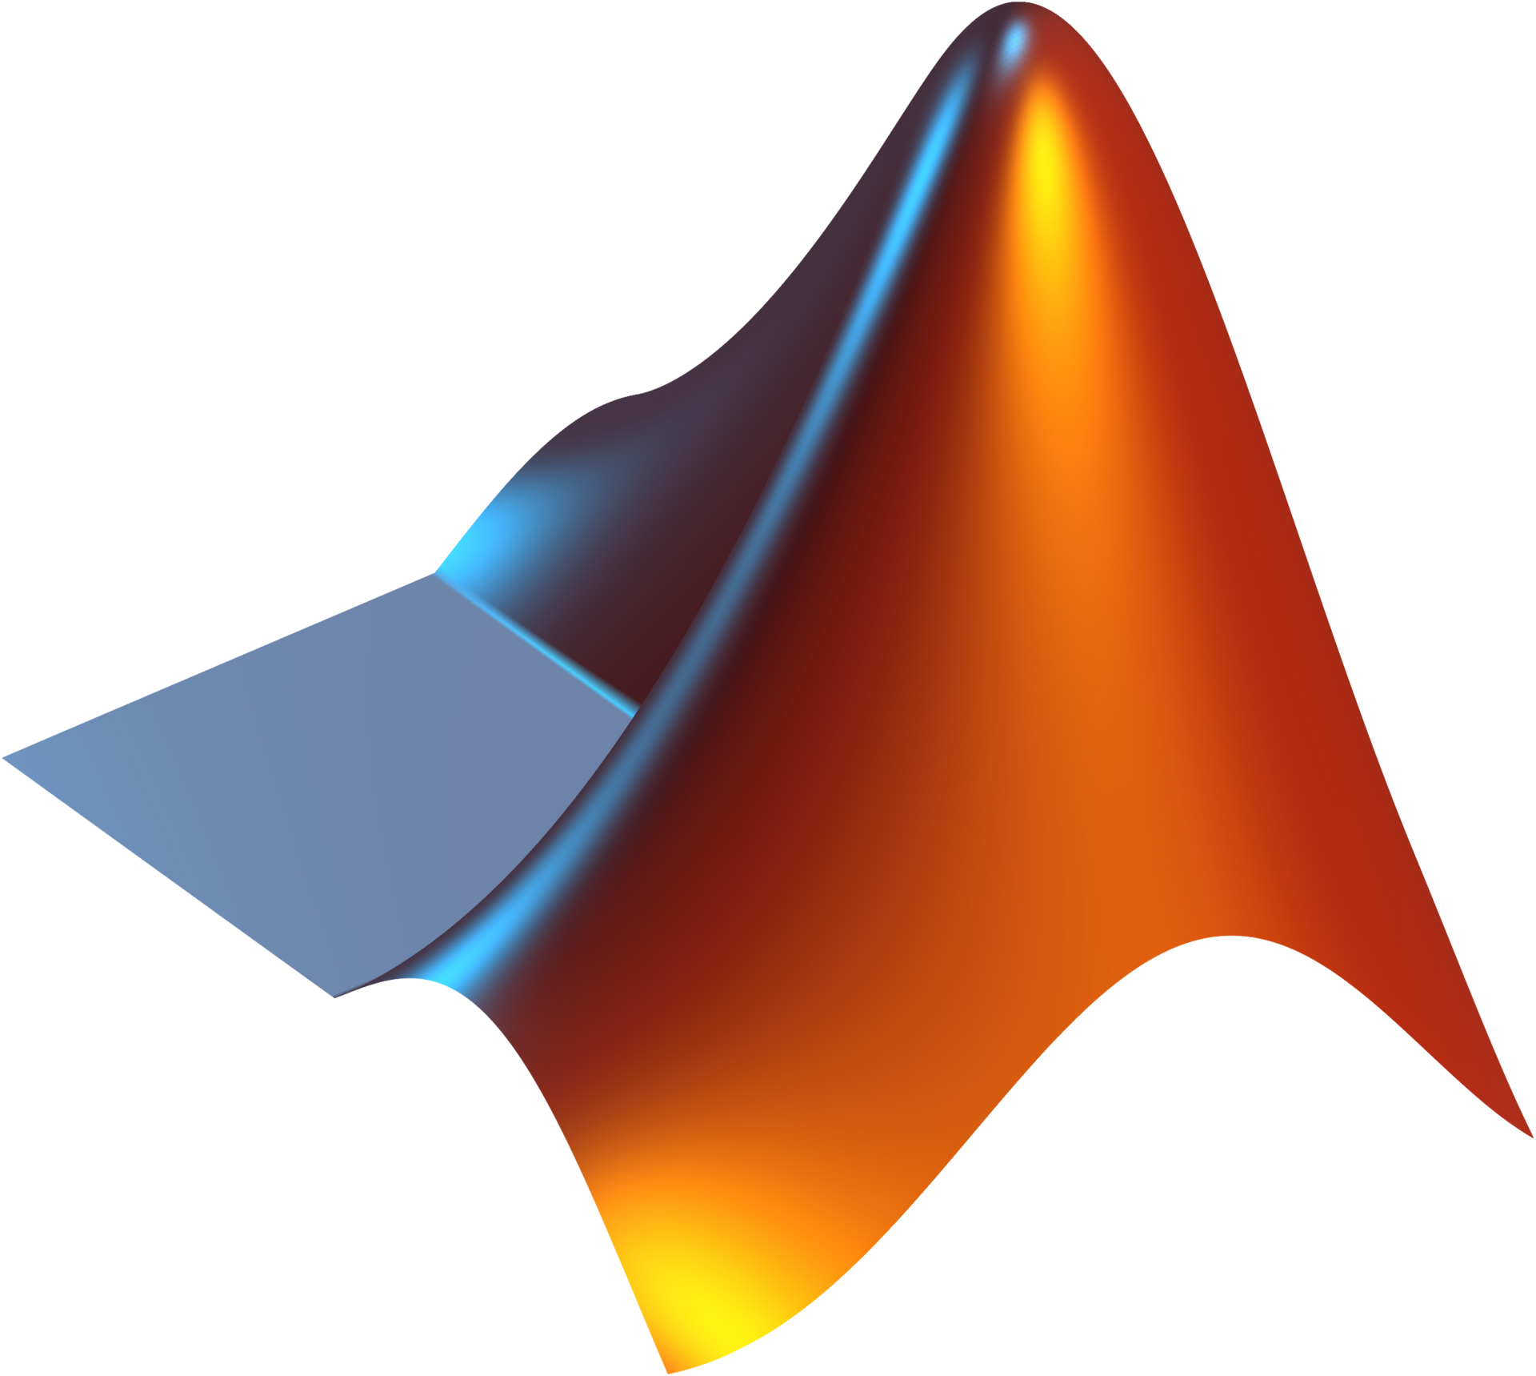


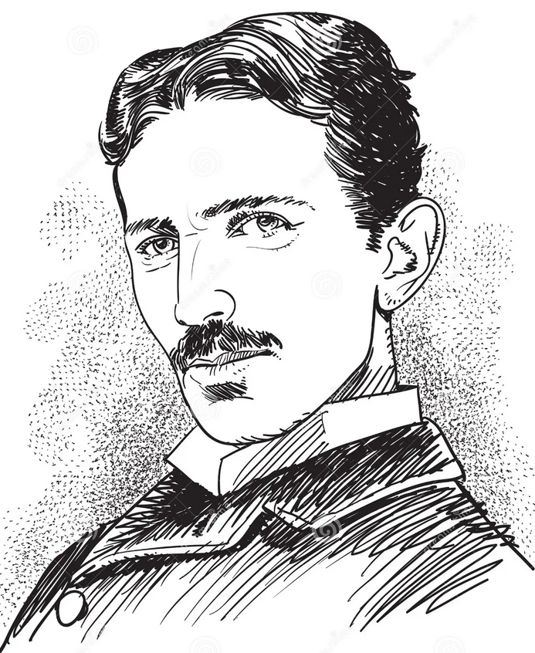


About this program
A brief introduction to the basic electronic engineering
Multiple DIY-level designs
A tutorial of design and simulation tools
A little bit math

Slide 4
On what level do we design?
“Software”
Product
Device on sale
Embedded System
System Level
Module
Too soft
Too big
Too easy
Hardware
Circuit Level
Custom PCB
Too hard
Too specific
Too hard
Physics, electro-chemistry
IC design
Discrete transistors
Semiconductor
Fricking vacuum tubes

Slide 5
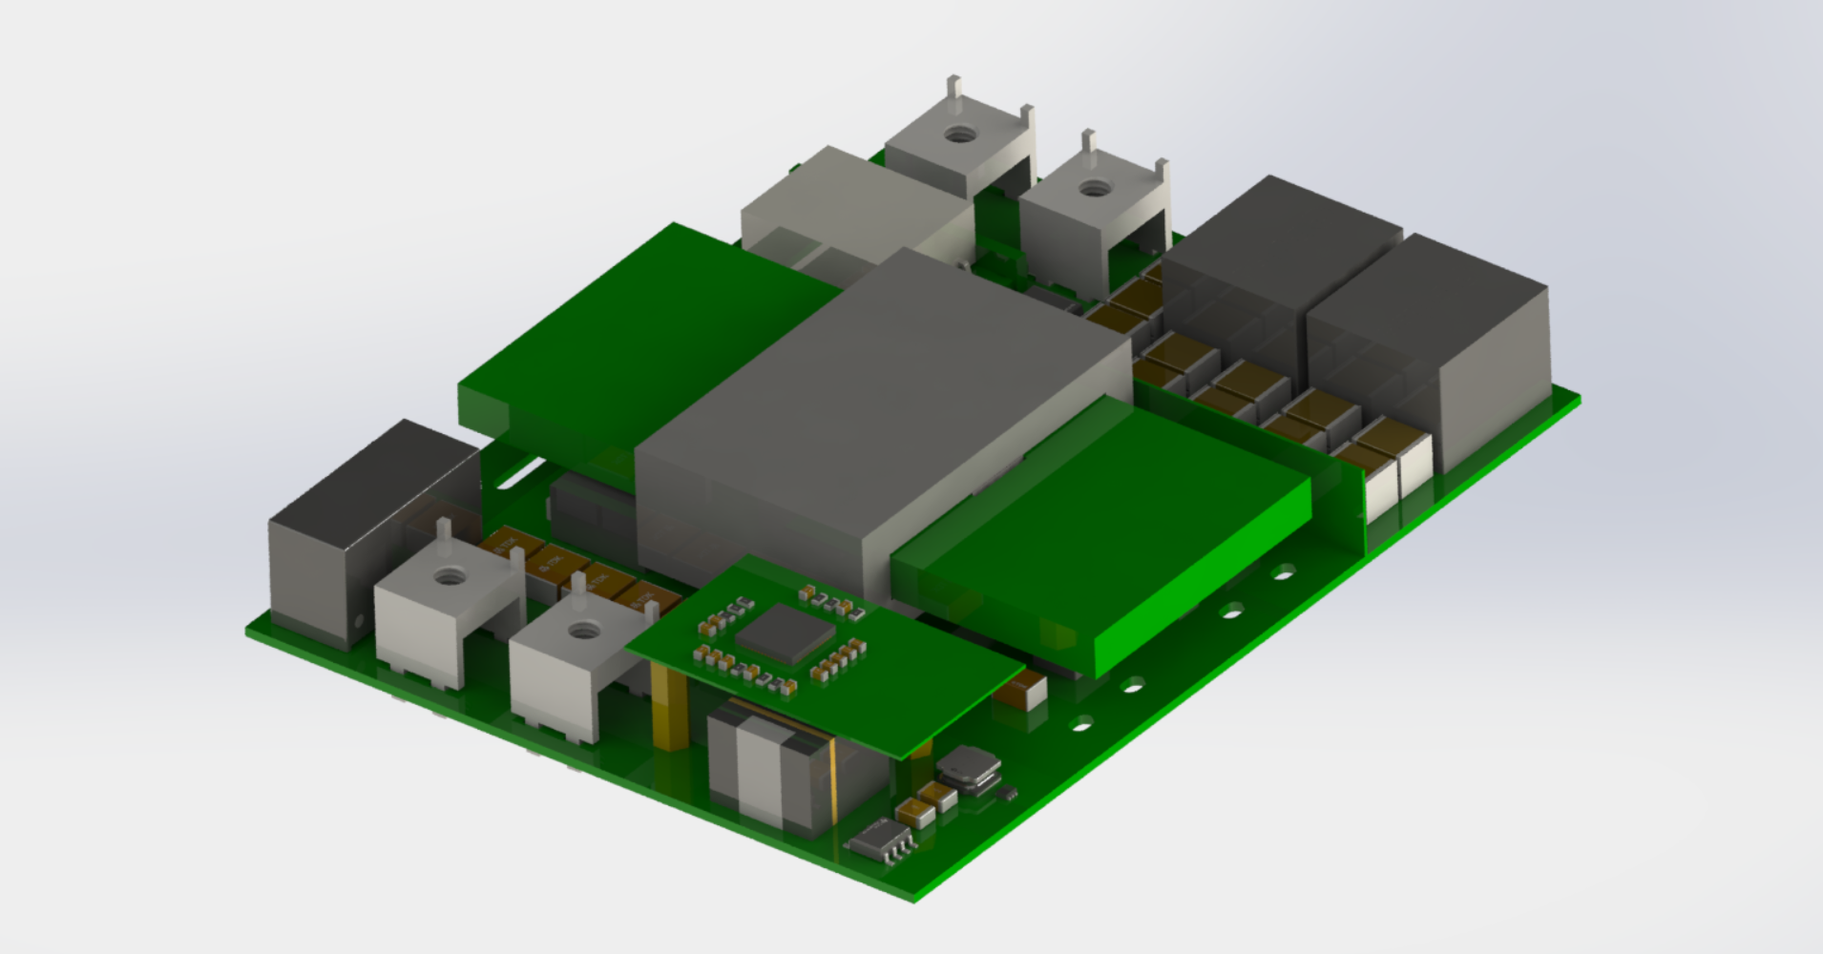
Example: Power Supply
Circuits based on
discrete components
Planer transformer
Dazzling DSP controller
A combination of
dozens of ICs
1kW Bidirectional Isolated DC/DC Converter
2024 czy, zhl, pjb, gan

Slide 6
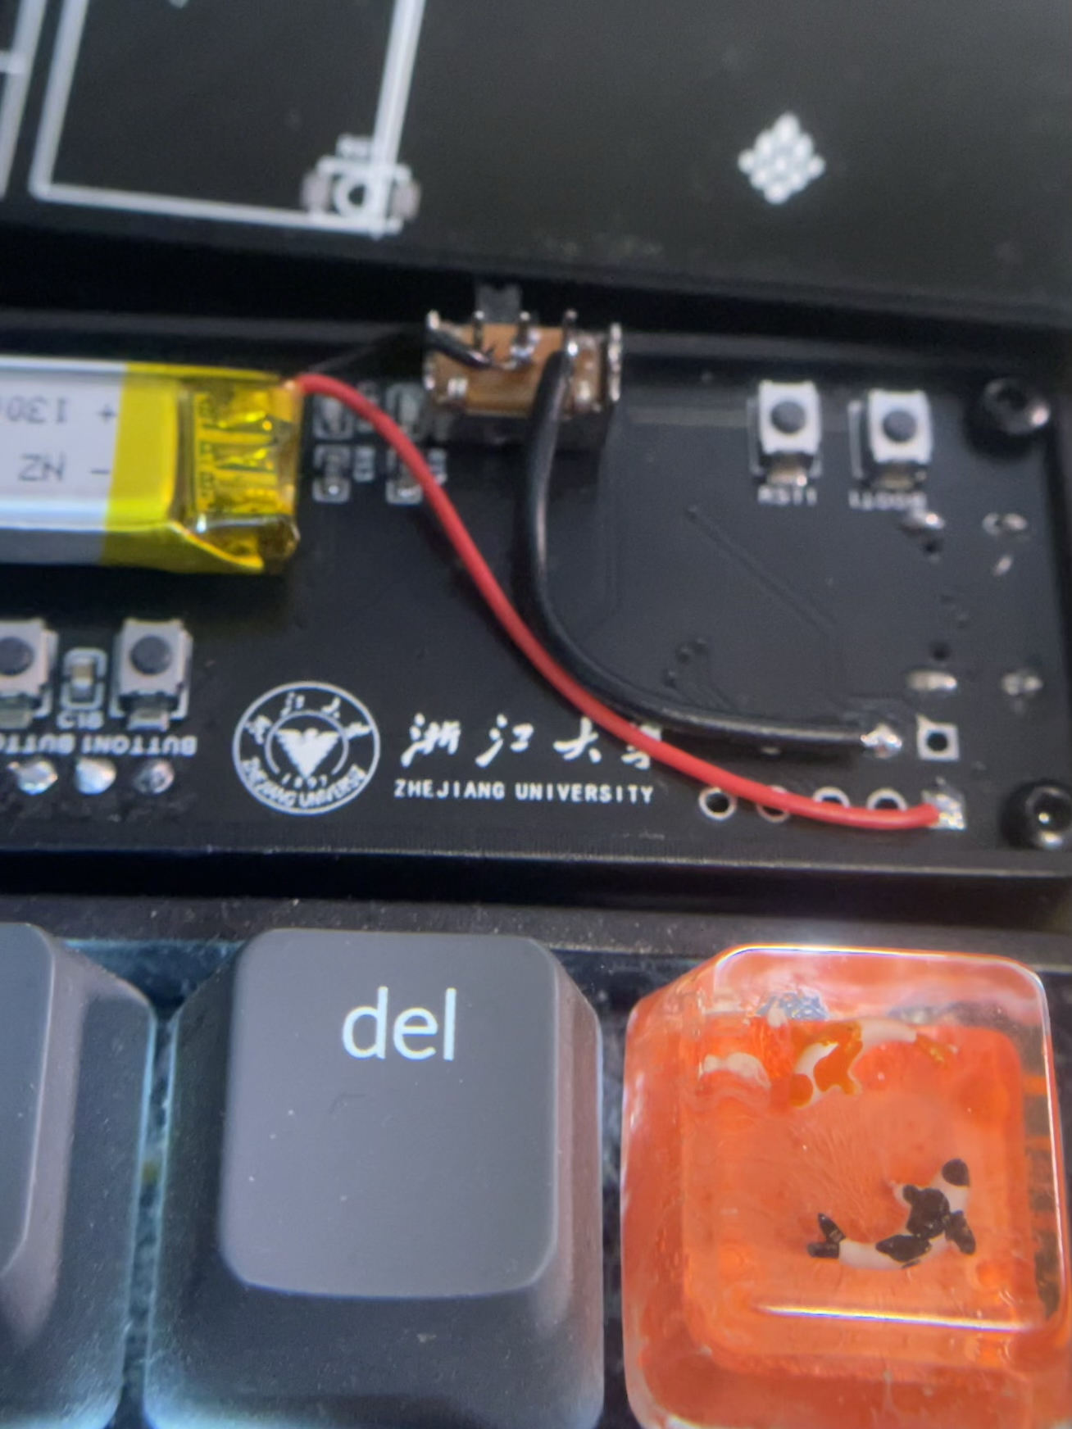
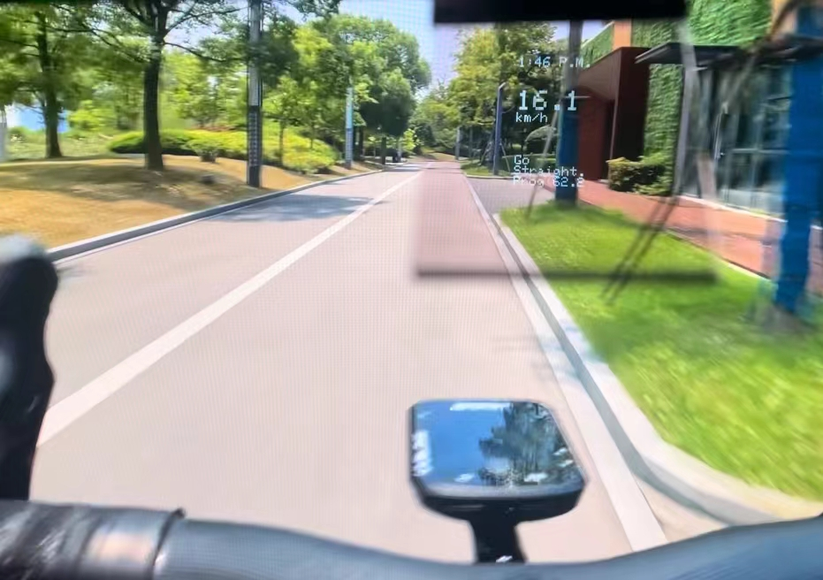
Example: Embedded Hardware
PCBs
AR-Track
2023-2024, Bowen Ye
https://github.com/AAAAyl0n/AR-Track

Slide 7
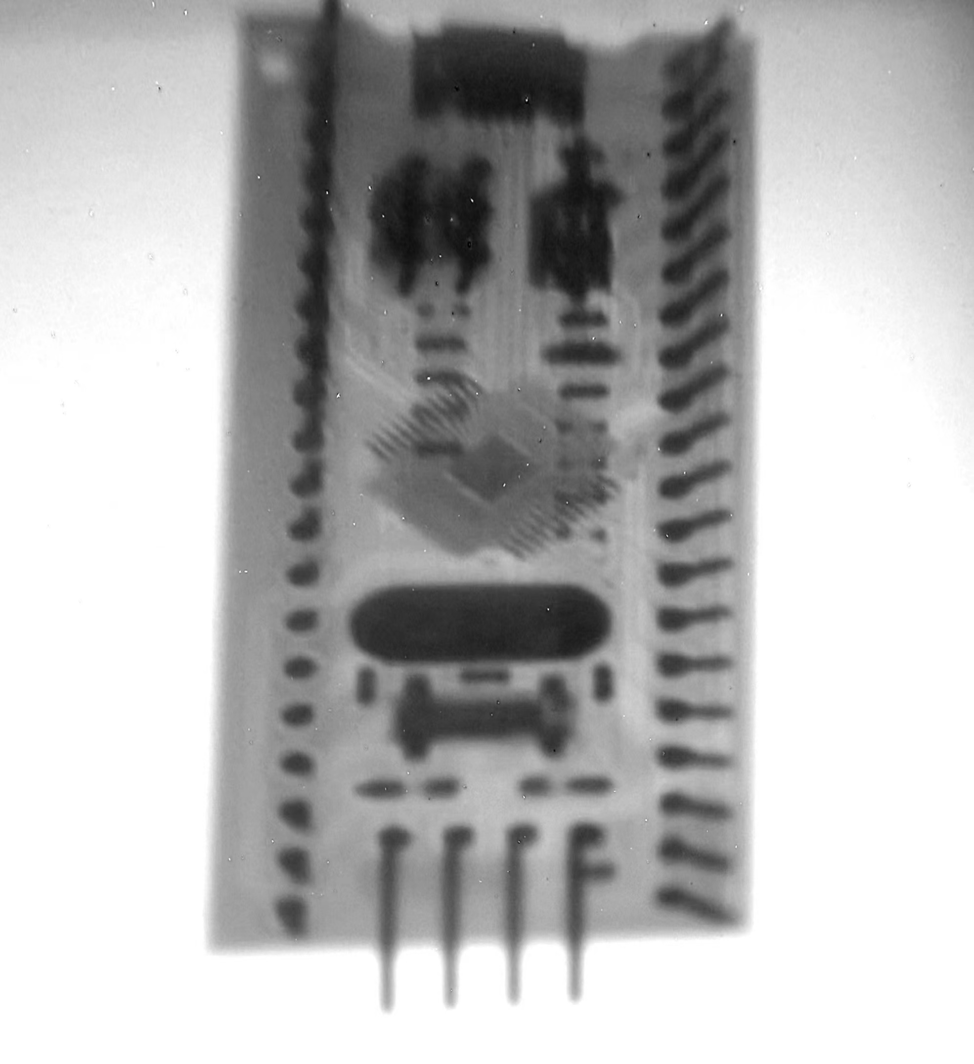
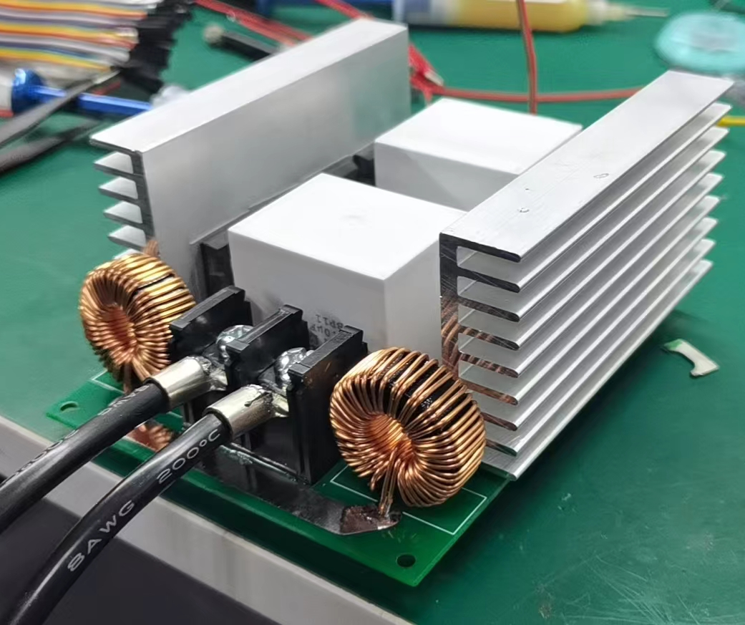
Example: Crazy Ideas
60kV 100W Xray
2022, Zhiyang Tsao

Slide 8
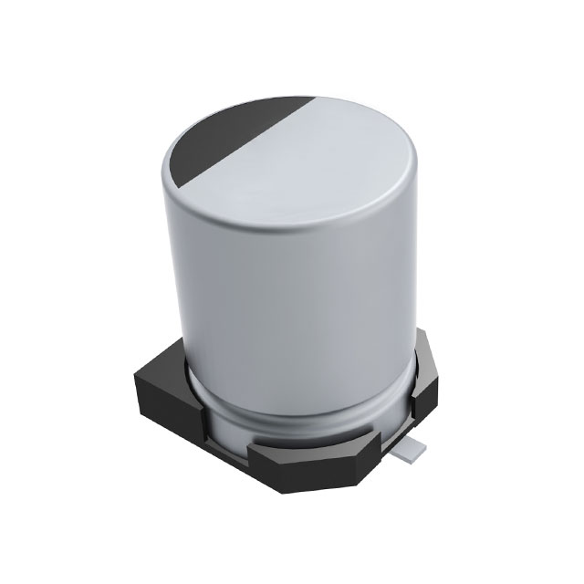
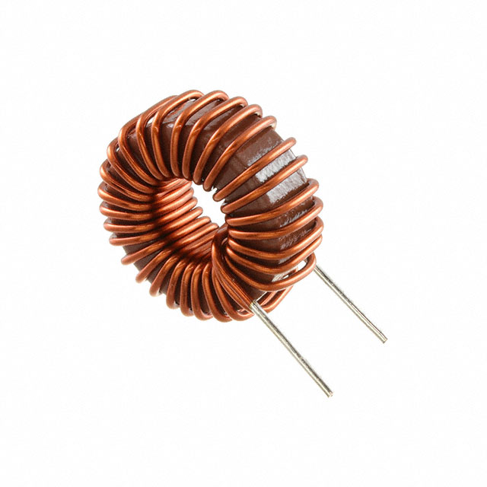
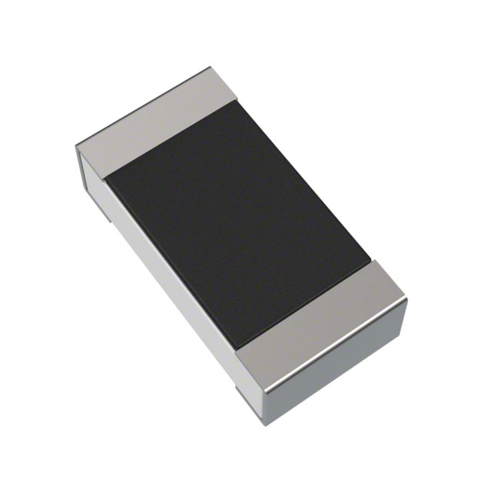
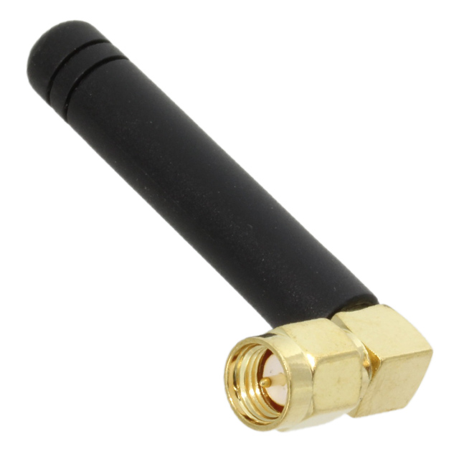
Passive Components
Passive = It only receives energy / it needs no auxiliary supply /
it is incapable of power gain
Resistor
电阻
Capacitor
电容
Inductor
电感
Antenna
天线

Slide 9
Resistor

